Slide 1
The European Citizen Action Service presents: “5 Takeaways on Brexit: Outlining Possible Scenarios for a New UK-EU Relationship and their Impact on Citizens”

Slide 2
Who we are
Brussels-based NGO with over 25 years of existence
Mission:
Empower citizens to exercise their rights in the EU
Promoting open and inclusive decision-making process at EU level
How we do this?
Training and capacity building
Information services
Research, advocacy, events, etc.

Slide 3
Why this study
Many studies on economic & trade implications of Brexit
… but few on actual implications for EU citizens’ rights
Yet over 4 million citizens directly impacted
Joined efforts with other CSOs in summer 2016
European Disability Forum
EU Rights Clinic
New Europeans
& additional ad hoc partners & supporters

Slide 4
The overarching project
Timeframe: Dec 2016 – Aug 2017
Aims:
General awareness-raising about Brexit options and their impact on citizens’ rights
Information to professionals providing advice to citizens
Campaigning and advocacy for the best possible deal for citizens
Study is the starting point

Slide 5
5 Takeways on Brexit: Outlining possible scenarios for a new EU-UK relationship

Slide 6
The structure
Part I: Brexit & citizens’ rights
Full EU membership (baseline scenario)
New settlement for the UK (Cameron’s failed deal)
Norway model (EEA membership)
Switzerland model (bilateral agreements)
Canada model (FTA)
Turkey’s model (Association Agreement)
Part II: Brexit & access to EU funding

Slide 7
Part I: Brexit & Citizens’ rights

Slide 8
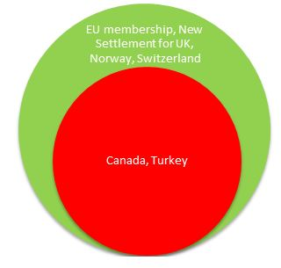
RIGHT TO ENTRY
EU membership: EU citizens only need a valid ID card/passport to enter an EU country & non-EU family members can obtain a visa for free with accelerated procedure
Canada model: no FoM of people foreseen in CETA. Right of entry subject to national immigration law & common rules on entry to Schengen area. Canadians exempted from visa for up to 90 days
Turkey model: EC-Turkey Association Agreement does not foresee a right of entry for Turkish nationals, who are required to hold a visa
No access
Partial/voluntary/special arrangement
Full access

Slide 9
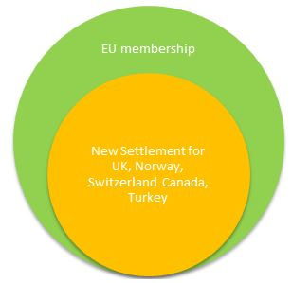
RIGHT OF RESIDENCE
EU Membership: EU citizens & their family members have the right to reside in other EU Member States
No requirements for residence < 3 months
Requirements for > 3 months & automatic right to permanent residence after 5 years
In practice UK already applies restrictions (jobseekers & narrow approach to conditions attached to residence of economically inactive EU citizens)
“safeguard measures” (Norway model) & no right of permanent residence (Switzerland model)
Canada model: right of residence subject to national legislation. But CETA allows temporary transfers of key personnel, business visitors & investors
Turkey model: gradual accumulation of residence & work-related rights for Turkish workers registered as belonging to the labour force of a MS & their family members
unless they are family members of an EU citizen!
also EU migration rules for researchers, students, seasonal or highly-skilled work

Slide 10
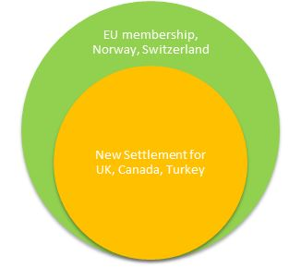
RIGHT TO WORK
EU membership: EU citizens & family members can look for a job in the EU under the same conditions as country nationals & receive assistance by national employment office
In practice UK has already introduced restrictions (‘minimum earnings threshold’, restrictions on jobseekers)
Canada model: CETA does not guarantee a general right to work. But it allows corporate transfers & temporary service provision by self-employed for limited time without work permit or prior approval
Turkey model: the right of Turkish nationals to move to an EU country to take up their first employment is governed by law of the host country, but gradual accumulation of EU rights

Slide 11
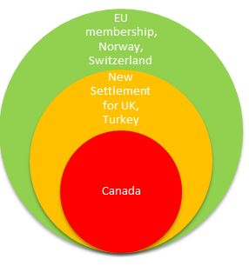
SOCIAL SECURITY
EU membership: EU has rules in place for the coordination (not harmonisation) of social security systems.
First 3 months: MS not obliged to grant social assistance to jobseekers or unemployed
>3 months: social assistance may be made conditional upon certain conditions
Workers entitled to social assistance
Turkey model: measures under the Association Agreement have extended the benefit of EU rules on social security coordination to Turkish workers (not fully implemented)
Canada model: social security rights not guaranteed in CETA

Slide 12
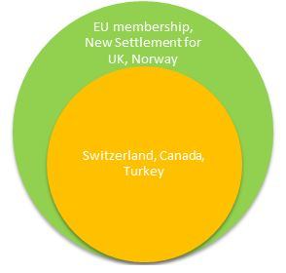
RIGHT TO DO BUSINESS, CONSUMER & PASSENGER RIGHTS
EU membership:
freedom of establishment & provide services
Consumer rights and passenger rights have a wider scope
Switzerland model:
AFMP covers individuals who want to establish themselves as self-employed in CH or provide services there. But companies not covered
No general agreement on FoM of services (only in a limited manner)
Canada model: CETA only foresees the temporary stay in the parties’ territories of natural persons (not companies) for business purposes. Also some provisions on temporary cross-border provision of services , but sensitive sectors excluded
Turkey model: AA does not provide for the right of establishment or freedom to provide services. Chapters foreseen in the EU accession talks but not yet opened. Conditions determined by national law
In the area of consumer protection & passenger rights most rights guaranteed at EU level are NOT restricted to EU citizens

Slide 13
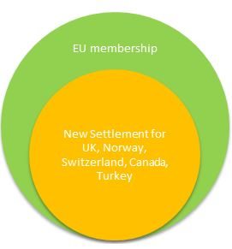
RIGHT TO NON-DISCRIMINATION
EU Membership:
EUCFR ph discrimination based on any grounds
Several EU instruments in place to combat discrimination (e.g. Directive 2000/78 on equal treatment in employment, gender equality Directives, etc.)
Norway & Switzerland: EUCFR does not apply but several provisions in EEA & AFMP ph discrimination (nationality). Norway also applies EU gender equality directives. Switzerland ratified ECHR
Canada model: No general provision ph discrimination in CETA. But some provisions on equal treatment & non-discrimination in limited fields
Turkey model:
Association Agreement ph discrimination on nationality grounds and Turkish workers legally employed in EU benefit from equal treatment regarding work conditions
Turkey has ratified ECHR, but legislation comparable to EU standards not yet adopted

Slide 14
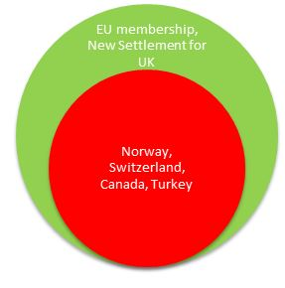
VOTING & POLITICAL RIGHTS
Only EU citizens can vote and stand as candidates in EU and local elections in the EU country where they reside (art. 20 and 22 TFEU)
Only EU citizens can participate in an ECI (art. 11(4) TEU) or seek consular or diplomatic protection from another EU country abroad (art 23 TFEU)
All these rights would be lost outside the EU

Slide 15
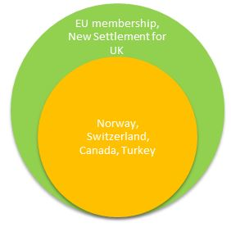
ACCESS TO EU INSTITUTIONS
EU citizens can interact with EU institutions in various ways (art. 15 & 24 TFEU)
Right to petition the EP
to correspond with any EU institution and receive a response in the 24 EU languages
to request access to public documents
to file a complaint before EU ombudsman
These rights are not limited to EU citizens, but can be exercised by non-EU citizens residing in the EU (including natural & legal persons)

Slide 16
In conclusion
There is no ‘best alternative’ to EU membership for EU citizens in the UK and UK citizens in the EU after Brexit
A choice will have to be made during the negotiations about which rights to retain for the more than 4 million EU and UK citizens directly affected
Turkish model as a common denominator?
Whatever choices are made, they should be arrived at in close consultation with citizens, social partners and elected representatives and not driven only by governments

Slide 17
Part II: Brexit & access to EU funding

Slide 18
Some conclusions
Brexit should not have dramatic consequences on access to EU public funds if UK agrees to continue to contribute to the EU budget
Participation of UK-based entities in EU funding achieved through an all-encompassing agreement or bilateral agreements with the EU
Automatic exclusion from EU funds limited to MS: ESIF & CAP
But restrictions on FoM or its outright repeal, could mean that UK-based organisations would no longer be eligible under some other programmes in current terms

