Slide 1
ECI Platform Inquiries
Preliminary training
17 April 2018

Slide 2
Freshfields team
Onno Brouwer, Partner
ACT, Amsterdam and Brussels
Angeline Woods, Principal Associate
ACT, Brussels
Daniel Baker, Associate
ACT, Brussels
*ACT is Freshfields’ Antitrust, Competition and Trade practice.

Slide 3
Agenda
Introduction to the ECI
History
Key stages / timeline
Legal test for registration
Practical tips for advising ECI organisers

Slide 4
Section 1
Introduction to the ECI

Slide 5
History
Treaty of Lisbon (2007)
- Treaty on European Union (TEU) Article 11(4)
- Treaty on the Functioning of the European Union (TFEU), Article 24
- Regulation (EU) No 211/2011 (ECI Regulation) – from 1 April 2012
Novel instrument of participatory / direct democracy
65 citizens’ initiatives launched so far – 4 successful (April 2018)
- 17 refused registration
- 14 withdrawn
- 24 insufficient support
- 6 open
- 4 successful

Slide 6
Key stages / timeline
ECI procedure step-by-step
LEGAL TEST
Set up citizens’ committee
Registration & certification of online system
Collection of signatures
Verification
Submission to EC
Examination & public hearing
7 citizens
7 Member States
2 months +
1 month
Max. 12 months
1 million signatures
7 Member States
`
Max. 3 months
No time limit
3 months following submission
Registration is the first hurdle in the life of an ECI.
ECI Support Centre helps organisers meet the legal test.

Slide 7
Legal test for registration
4 conditions – Article 4(2) ECI Regulation
“The Commission shall register a proposed citizens’ initiative […] provided that the following conditions are fulfilled:
(a) the citizens’ committee has been formed...
(b) the proposed citizens’ initiative does not manifestly fall outside the framework of the Commission’s powers to submit a proposal for a legal act of the Union for the purpose of implementing the Treaties
(c) …is not manifestly abusive, frivolous or vexatious
(d) …is not manifestly contrary to the values of the Union in Article 2 TEU”
So far, the Commission has over ever rejected proposed citizens’ initiatives on the basis that the proposal was ‘manifestly outside’ its powers (Article 4(2)(b) ECI Regulation)

Slide 8
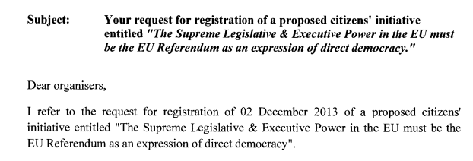
Sample rejection decision

Slide 9
Getting an ECI registered
Arts. 3-6 TFEU
1. Policy area where EU has competence
3. A ‘legal act’
2. Legal basis in the Treaties
Regulation
Directive
Decision
Recommendation (non-binding)
Opinion (non-binding)
‘Legal acts’ within the EU legal order (Art. 288 TFEU)

Slide 10
Section 2
Practical tips for advising ECI organisers

Slide 11
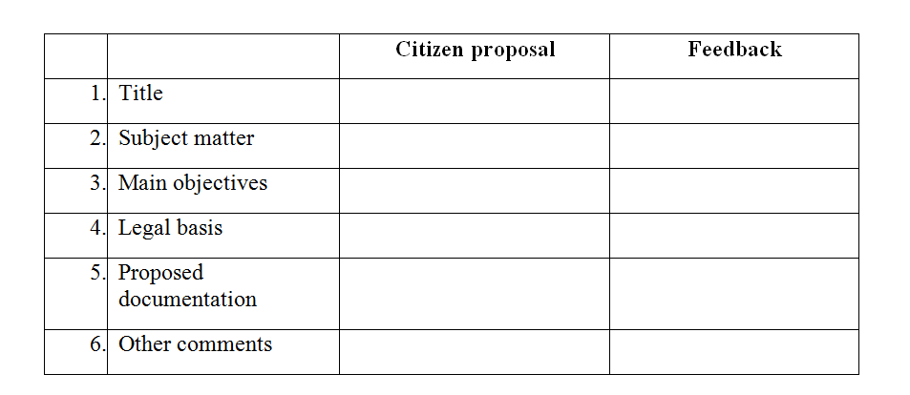
Template response
All inquiries to the platform should be reviewed in accordance with the following criteria (and a consistent template response prepared)
Annex II to ECI Regulation has a list of information organisers must provide – see backup slide

Slide 12
Golden rules for providing feedback
Check Guidance and all relevant FAQs on ECI website
Check for existing / prior similar ECIs – were they successful?
Avoid statements that could inadvertently prejudice the success of the proposal

Slide 13
Title of the initiative
Should be no more than 100 characters – check!
No other particular legal requirement as to the title of the initiative. However, consider some constructive guidance – e.g. does the title accurately convey the subject matter?

Slide 14
Subject matter
Should be no more than 200 characters – check!
The subject-matter must specify: what ‘legal act of the Union’ is proposed – check!
This may be binding legislation Regulation, Directive, Decision or a non-binding act (Recommendation or Opinion)
Consider whether the proposed legal act is appropriate in the circumstances and consider constructive feedback if there are reasons to consider that a different legal act would be more appropriate

Slide 15
Main objectives
Should be no more than 500 characters – check!
The main objectives should clearly (and briefly) articulate the main objectives to be achieved from the proposed ECI
The main objectives should make clear what outcomes are sought by the proposed ECI
Consider constructive advice to improve the main objectives - e.g. is the content and focus accurate?

Slide 16
Legal basis
A legal basis upon which the Commission can act is required – check!
Review carefully the proposed Treaty articles. If no legal basis is stated, consider potential legal bases for consideration.
Treaty articles which refer to the ‘ordinary legislative procedure’ or the ‘special legislative procedure’ can be used for an ECI.
The Commission is empowered to propose a legal act when: the article refers to a legislative procedure ("ordinary legislative procedure" or "special legislative procedure"), except in specific cases where the article provides otherwise (i.e. it specifically mentions that an institution other than the Commission makes the proposal) OR the article explicitly mentions that the Commission is responsible for making a proposal.
Remember: listing multiple articles won’t necessarily help to get registered! One legal base is sufficient (e.g. ECI “Stop Vivisection” was successful and based solely on Art 13 TFEU).

Slide 17
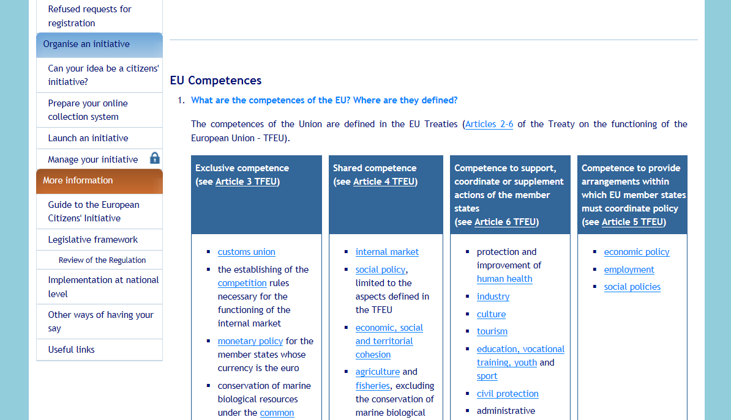
http://ec.europa.eu/citizens-initiative/public/competences/faq#q2

Slide 18
Proposed documentation
Required details – check!
Personal details of the 7 required committee members (full names, postal addresses, nationalities and dates of birth), indicating specifically the representative and his/her substitute as well as their e-mail addresses and telephone numbers
Documents that prove the full names, postal addresses, nationalities and dates of birth of each of the 7 members of the citizens’ committee
All sources of funding and support for the proposed citizens' initiative (known at the time of registration) worth more than €500 per year and per sponsor

Slide 19
Back-up materials

Slide 20
Requirements for registering an initiative
Annex II of the ECI Regulation
“The following information shall be provided in order to register a proposed citizens’ initiative on the Commission’s online register:
The title of the proposed citizens’ initiative
The subject matter
A description of the objectives
The provisions of the Treaties considered relevant by the organisers for the proposed action
The full names, postal addresses, nationalities and dates of birth of the seven members of the citizens’ committee
All sources of support and funding at the time of registration.”

