Slide 1
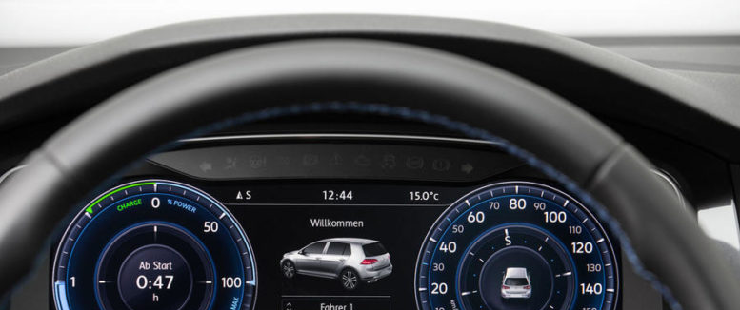
DEEP –linking Youth
Fraser Henderson
@frazzy123

Slide 2
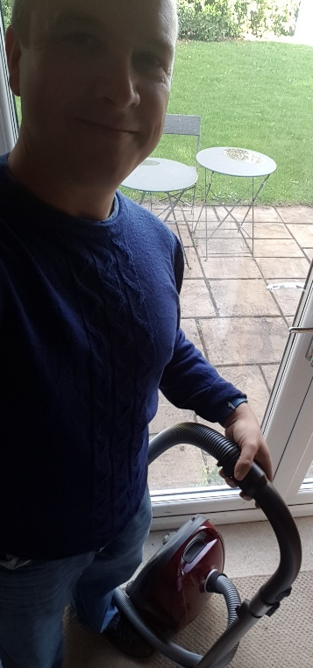
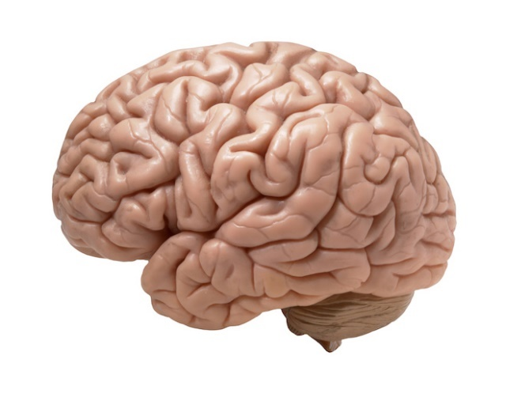
Power in everyday influence
This deal sucks
Notes:
They public can prompt questions and ways of looking at issues that may not have occurred to the experts caught up in the debate
They enable one to penetrate well beyond opinion polling, to understand not just what people say they think but how and why they think it, how they might consider trade-offs, and what might stimulate them to think differently

Slide 3
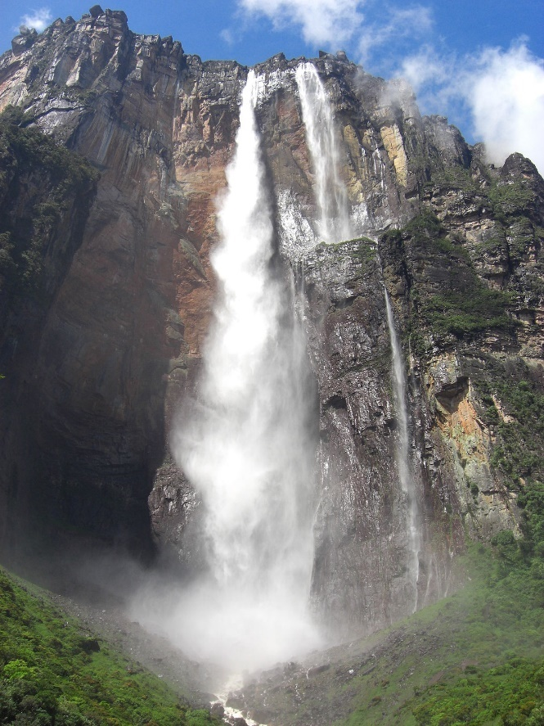
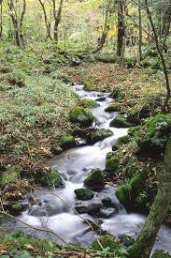
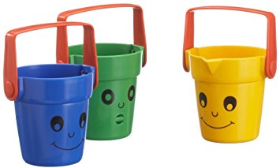
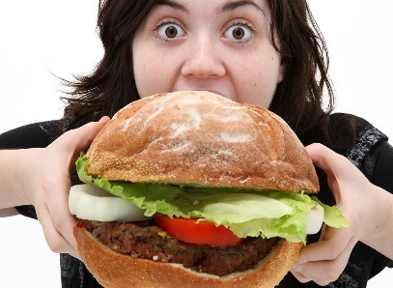
Bags are OK
FILTERS
AI (2%)
DASH (<1%)
Notes:
They public can prompt questions and ways of looking at issues that may not have occurred to the experts caught up in the debate
They enable one to penetrate well beyond opinion polling, to understand not just what people say they think but how and why they think it, how they might consider trade-offs, and what might stimulate them to think differently

Slide 4
Monitoring Debate
Formal Consultation
Between people, organisations, friends, peer groups, professional networks….
Between consultor and consultee
Youth Mobility
Right People
Right Questions
Right Time
Anybody
Anything
Anytime
Less relevant
More relevantnt
Notes:
They public can prompt questions and ways of looking at issues that may not have occurred to the experts caught up in the debate
They enable one to penetrate well beyond opinion polling, to understand not just what people say they think but how and why they think it, how they might consider trade-offs, and what might stimulate them to think differently

Slide 5
Scraping insights on “youth mobility”
#travel
#friends
#France
#Germany
#Spain
Notes:
They public can prompt questions and ways of looking at issues that may not have occurred to the experts caught up in the debate
They enable one to penetrate well beyond opinion polling, to understand not just what people say they think but how and why they think it, how they might consider trade-offs, and what might stimulate them to think differently

Slide 6
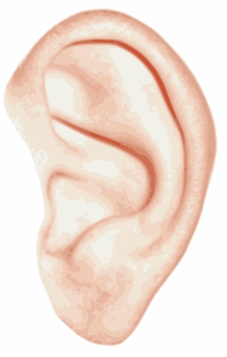
“So, you think that punishing students is a welcome side effect of leaving the EU.”
“Having both parents [work abroad] is fun and games till they're back & smoking can no longer be done indoors 😤”
“But what do you think uniovi charging 10 euros for each language you submit to the Erasmus test (some charging 60)”
UNIVERSITY
“This night I dreamed that I was taking [Erasmus] in Australia. I cried. I think this story stresses me too”
“Go to Erasmus is a waste of time and money of your parents”
TRAVEL
“Instead of the money, free train ticket”
FINANCES/BREXIT
Notes:
They public can prompt questions and ways of looking at issues that may not have occurred to the experts caught up in the debate
They enable one to penetrate well beyond opinion polling, to understand not just what people say they think but how and why they think it, how they might consider trade-offs, and what might stimulate them to think differently

Slide 7
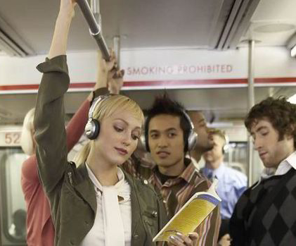
"You have to think internationally at an early age. More international, more inclusive and more effective"
Gold exists
Not self selecting
Now
Notes:
They public can prompt questions and ways of looking at issues that may not have occurred to the experts caught up in the debate
They enable one to penetrate well beyond opinion polling, to understand not just what people say they think but how and why they think it, how they might consider trade-offs, and what might stimulate them to think differently

Slide 8
Dig for perspectives
Refute or confirm existing research
Compliment traditional consultation
Notes:
They public can prompt questions and ways of looking at issues that may not have occurred to the experts caught up in the debate
They enable one to penetrate well beyond opinion polling, to understand not just what people say they think but how and why they think it, how they might consider trade-offs, and what might stimulate them to think differently

Slide 9
http://deeplinkingyouth.eu/

